Slide 1
... the first 200 years
Ian Graham
www.iangraham.org
Notes:
This talk is about the first 200 years of networked communication
Because this is fascinating to me, and talks to the long standing drive of people to communicate, for many different reasons!
So although it sounds like a set of boring technical facts it really a story of people, and of how technology is one key attribute of our own social evolution.

Slide 2
(hi)story technology evolution innovation
Notes:
So although technology is the key theme of this talk, I don’t really want to focus solely on the machinery.
Instead I want to bring to life the stories, people and social conditions of this history, and that both led to the evolution of networking technologies, and resulted from these technologies being put into place.
I also want to talk about the innovation that happened along the way – and how the technologies themselves have, over time, helped develop the culture of innovation we see today.

Slide 3
25 December, 1763 b. Claude Chappe
Notes:
The story long distance communication networks goes back over 2000 years, to human and horse relays, pigeons, smoke signal and fire beacons, heliographs, hydraulic telegraphs, flags, and likely more. Indeed, you could easily write a history of humanity from the perspective of our desire to communicate, for an uncountable number of reasons over long distances.
But here I want to focus on the last 200 or so years, on the origins of the original data networks that lead directly to the Internet.
So our story begins with Claude Chappe: born on Christmas day, 246 years ago.

Slide 4
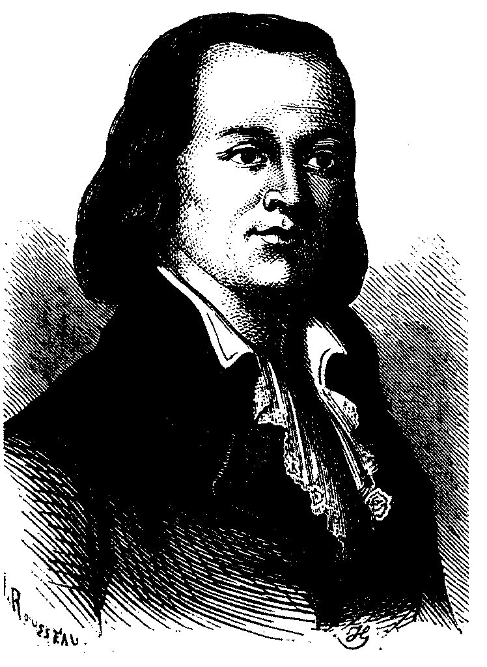
Notes:
Claude was the second of eight children, born in the small town of Brûlon, about 200km southwest of Paris in the region today known as Sarthe, Pays-de-la-Loire.
Claude was born into a Baronial family of modest wealth and, as was typical at the time and given his family’s circumstances, Claude was “raised for the church”, graduating from the Seminary in 1783. During his schooling Claude demonstrated both a strong interest and aptitude in physics and the physical sciences.
Upon graduation he took up two paid positions (benefices) in local parishes, and settled into a stable life. He still retained his interest in physics, performing experiments on his own and with colleagues, and joining a prestigious physics society (Societé Philomatique) in Paris. For those who know physicists, Chappe was a member of the same society as Lavoisier, Laplace, Gay-Lussac, Ampère, Cauchy, Fresnel, Pasteur, H. Becquerel, De Broglie, and Joliot.
Claude is not so well known as them. But for Claude, life was good.
Graphic: http://en.wikipedia.org/wiki/File:Claude_Chappe.jpg

Slide 5
14 July, 1789
Notes:
But things changed in 1789.
Footnotes and references & Sources
http://people.seas.harvard.edu/~jones/cscie129/papers/Early_History_of_Data_Networks/Chapter_2.pdf
http://openlearn.open.ac.uk/mod/resource/view.php?id=170049
http://en.wikipedia.org/wiki/Telegraphy
The Early History of Data Networks, Gerard J Holzmann and Björn Pehrson, Wiley, 1994 (Chapter 2). http://people.seas.harvard.edu/~jones/cscie129/papers/Early_History_of_Data_Networks/Chapter_2.pdf
http://science.jrank.org/pages/6720/Telegraph.html
http://chappe.ec-lyon.fr/
http://www.bookrags.com/research/semaphore-woi/

Slide 6
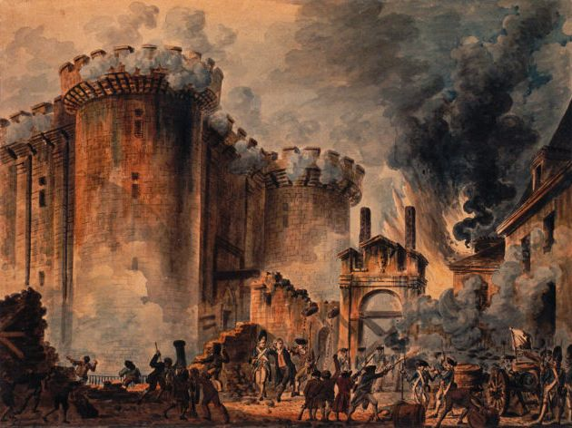
Notes:
The revolution had widespread impact across France, and Europe. Notable for Claude was the impact on the Catholic church -- Claude lost his paid positions in November. His brothers also lost their religious and civil service jobs, and they reunited at home, to figure out what to do.
They decided to work together on developing a mechanism for communicating messages across long distances, which they could sell to the government .
This was not a surprising goal: the idea had been around for quite some time, and others were interested – and indeed had attempted – this same task. But the brothers felt that, with Claude’s scientific skill and expertise (he had a reputation for drive and perfection), and with their connections to the government, they were well positioned to succeed.
The brother’s set to work in 1990. ENTREPRENEURS!
By way of context, this was the beginning of the industrial revolution. Ships were sill powered by sail, but James Watt had, only a few years earlier (1769) introduced the steam condenser that led to the true age of steam power.
Painting: The Taking of the Bastille, by Jean-Pierre Houel, 1789. This graphic comes from the wikimedia commons: http://en.wikipedia.org/wiki/File:Prise_de_la_Bastille.jpg

Slide 7
2 March, 1791
"si vous réussissez, vous serez bientôt couverts de gloire"
Notes:
The brothers completed and demonstrated their first pilot telegraph in 1791, with a short message sent over a distance of 10km. It was a success, and as a result they received funding to build out the first real telegraph line ...
Well sort of. It took a couple more years for this to be completed. A few problems, trying to do this in the midst of a revolution!

Slide 8
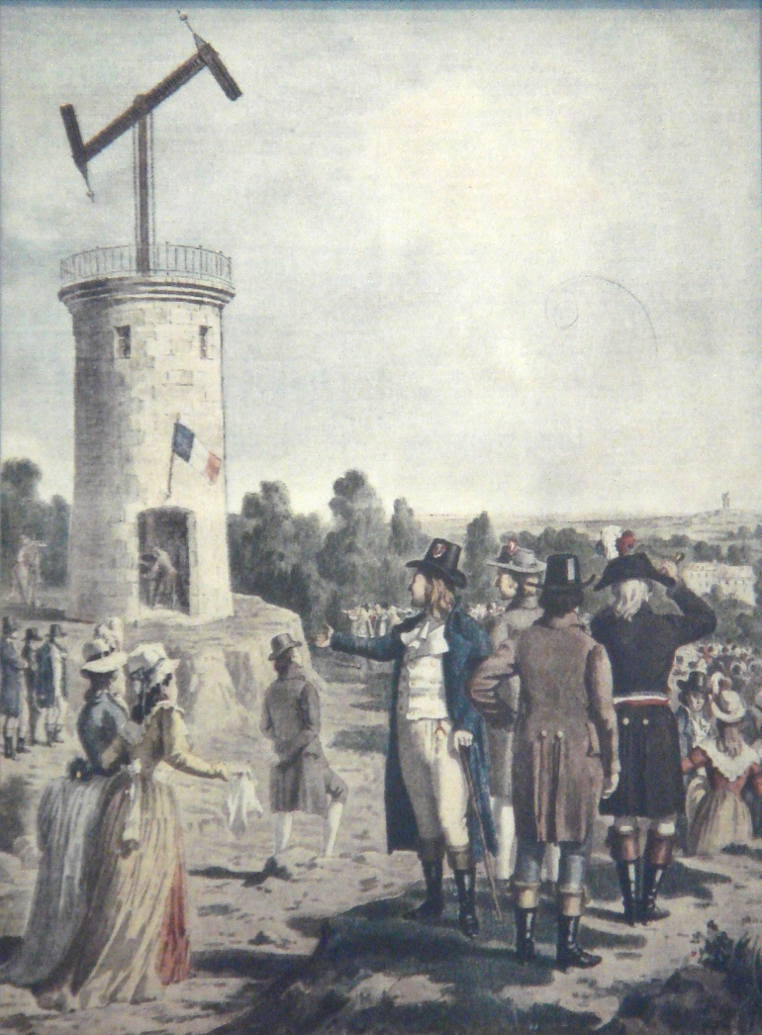
Notes:
They did some re-engineering and re-design, and the first true telegraph line was up and running in 1793,, from Paris to Lille, 150km away.

Slide 9
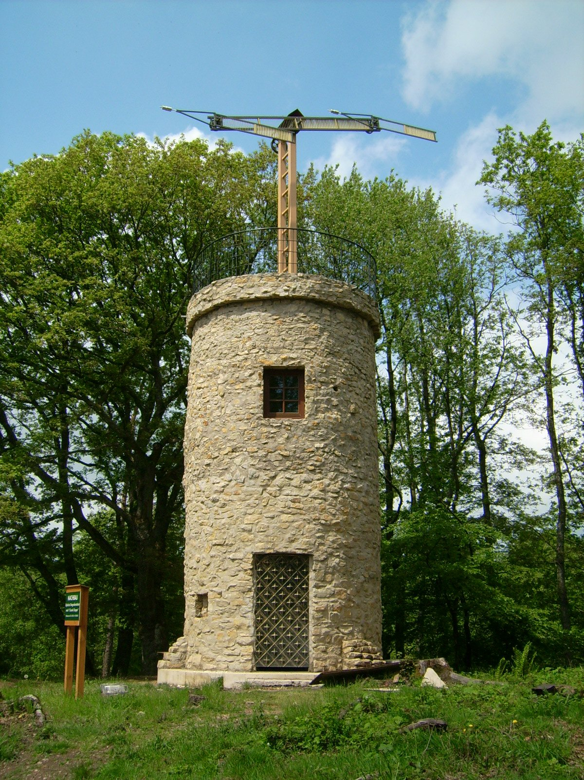
560 stations
4,800 km
~3 bits/sec (2→6 words/min) 1400 km/h
Notes:
Here is a reconstruction of a tower, showing the ‘semaphore’ vanes. The vanes supported 196 positions, each coding for a letter, number or control code (error, retransmit, suspend, shift code book, conflict, priority, acknowledge, idle, failure, etc.).
They used code books to hide/ compress / speed transmission of messages – the code book coded pairs of 92 of the basic symbols – for a total of 8464 coded words and phrases. This helped speed up transmissions, and also helped hide the messages from listeners – provided the code books could be kept secret.
NAPOLEON – How effective was this system? Roughly put, messages could be sent 90 times faster that by horse messenger . of huge improvement!
When Napoleon took power in 1799 he quickly saw the benefit of this to both control of France and improved management of the military. Napoleon quickly commissioned large-scale expansion of the network.

Slide 10
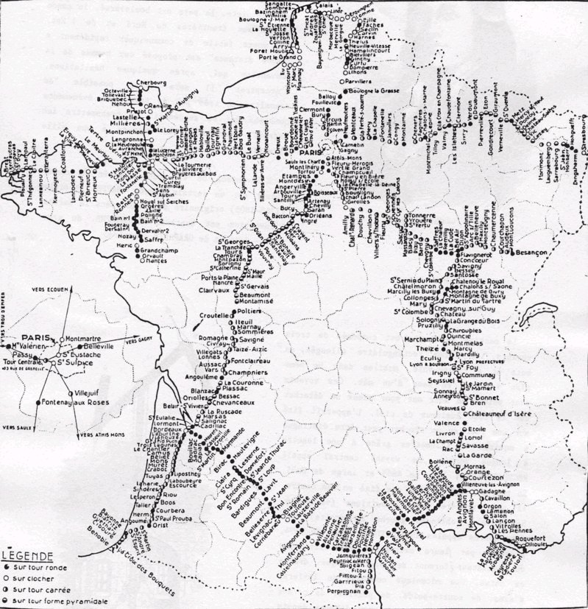
~1840
Notes:
By the early 1800’s France was interlaced with telegraphy towers (to help coordinate Napoleon’s military, in part). Similar networks were built in southern England and other countries. Still, the network really only consisted of dozens of real ‘stations’ – the rest being just repeater towers that passed the messages on.
Unfortunately, Claude did not live to see this success. Suffering from depression, and hounded by many complaints from others that he had stolen their ideas, he committed suicide on 23 January, 1805.
His brother’s kept up the work, and build out the huge network that crossed all of France.
The nature of networks management / ownership varied also. France’s network was a government monopoly, while in England there was a largely entrepreneurial approach.

Slide 11
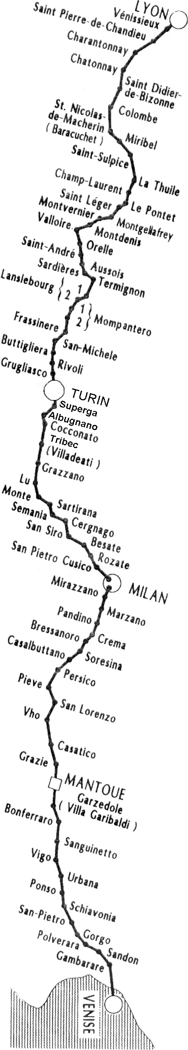
WAN
... short message from Amsterdam to Venice in one hour (~1600 kph). A horse messenger would need a month to do the same.
Military, government, some commercial use
Did send lottery tickets numbers, though.
Notes:
This figure gives a measure of the scale accomplished in such short order: in just 30 years optical telegraph went from an invention to a cross-continental network.
This quote is paraphrased from an article at the online LowTechMagazine -- http://www.lowtechmagazine.com/2007/12/email-in-the-18.html
Alexander Duma’s novel The Count of Monte Cristo includes optical telegraphy – one of the main characters uses the telegraph (and bribery) to trick an opponent into going bankrupt, through a false message.
Telegraphs also appeared in the Hornblower series of novels, by C.S. Forrester
See: http://en.wikipedia.org/wiki/Optical_telegraph#In_popular_culture
The book: http://www.classicreader.com/book/216/60/

Slide 12
telegraph
semaphore
control codes
Notes:
This era ended in the mid 1800s, as new technologies supplanted the optical approach.
Technology had advanced, and now new and better approaches were available to accomplish the same goals.
Still many terms from this era remain, not to mention place names such as “telegraph hill,” and the occasional preserved towers….

Slide 13

Notes:
Next came the electric telegraph. The first operational electric telegraph was launched in 1839, in England, based on a design by Wheatstone. The US came next, in 1844 (Samuel Morse), while France lagged to 1845 (they did love the mechanical towers!).
There are lots of great references on telegraphy. Here are a few
http://www.morsetelegraphclub.org/mtc_telegraph_docs.asp
Graphic from http://en.wikipedia.org/wiki/File:Double_Lightning_in_Glyfada-Athens.jpg

Slide 14
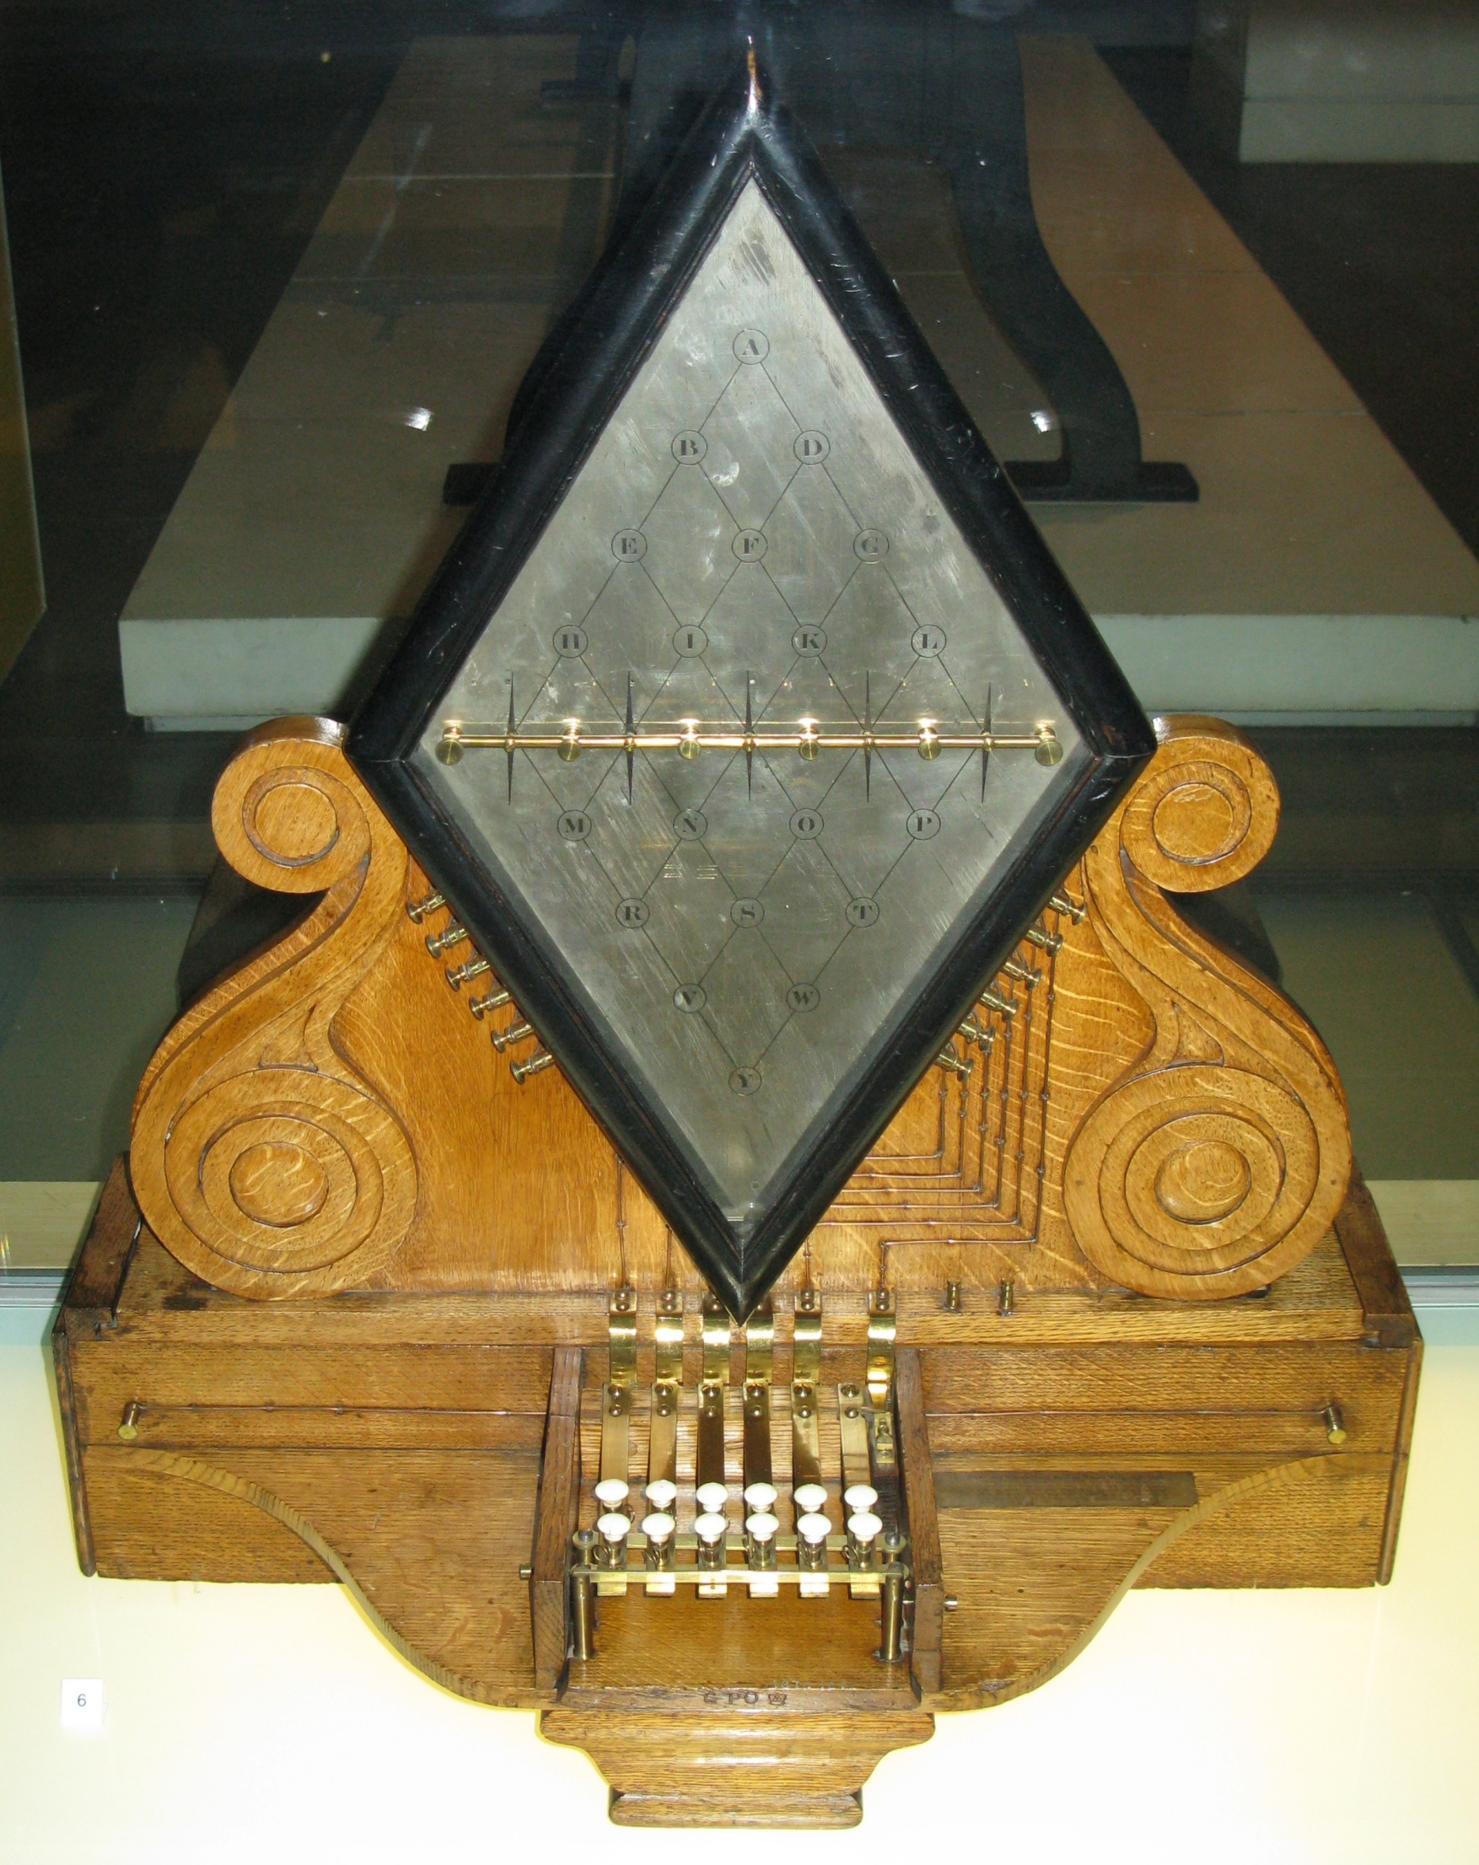
1837
Notes:
This is a Wheatstone telegraph – the character being transmitted/received is shown by the intersection of the arrows (turned by a magnetic field).
Charles Wheatstone and William Fothergill Cooke
(graphic from http://en.wikipedia.org/wiki/File:Cooke_and_Wheatstone_electric_telegraph.jpg
There were a bunch of variants, and simpler ones. But long term this was less efficient than the Morse telegraph, which came along later..
The idea was similar to optical telegraphy: a person would receive a message from a station, write it down, and retransmit it to the next station in the line. But by using wires and electricity the distances between stations could be much longer: plus things could work 24 hours a day, as opposed to just during daylight hours.
Moreover, technology improvements gave a big upside to electrical versus optical telegraphy. For example, improved cable design and amplifiers made underwater – and eventually transoceanic cables – possible, while electromechanically input devices, like teletypes, made input and output faster, and allowed for automated retransmission (people were no longer needed). And then radio and wireless opened up whole other channels of communication, and turned a point-to-point technology into a point→ many communications medium.

Slide 15
1 January 1845
...he is in the garb of a kwaker with a brown coat on which reaches....
Notes:
A...MURDER...HAS...JUST...BEEN...COMMITTED...AT...SALT...HILL...AND...THE...SUSPECTED...MURDERER...WAS...SEEN...TO...TAKE...A...FIRST...CLASS...TICKET...TO...LONDON...BY...THE...TRAIN...WHICH...LEFT...SLOUGH...AT...7.42PM......HE...IS...IN...THE...GARB...OF...A...KWAKER...WITH...A...GREAT...COAT...ON...WHICH....REACHES...NEARLY...DOWN...TO...HIS...FEET.......HE...IS...IN...THE...LAST...COMPARTMENT...OF...THE...SECOND...CLASS...COMPARTMENT
John Tawell in Slough to murder his mistress – takes train back to London....

Slide 16
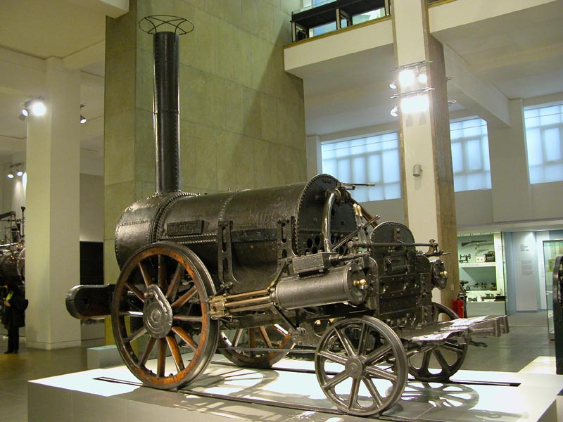
Notes:
This photo of the Stephenson “Rocket” – the first modern “locomotive”, built in 1829
Initial growth in telegraphy was synergetic with Railways: Railways needed ways of signaling / communicating between stations, so they could coordinate sharing of rail lines by different trains. Telegraphy let railways get way more utility out of the same rail infrastructure, so the business case for them was huge. All around the world there was huge boom in telegraph construction alongside existing and new railway lines.
This from http://en.wikipedia.org/wiki/File:Stephenson%27s_Rocket.jpg This simple model became the standard for telegraphy around the world.
Also of interest is the french Baudot code, which was the first true binary code -- used ‘5 bits’ to encode characters as sequences of on/off bits, of equal length.
This formed the basis for mechanically-driven telegraphy

Slide 17
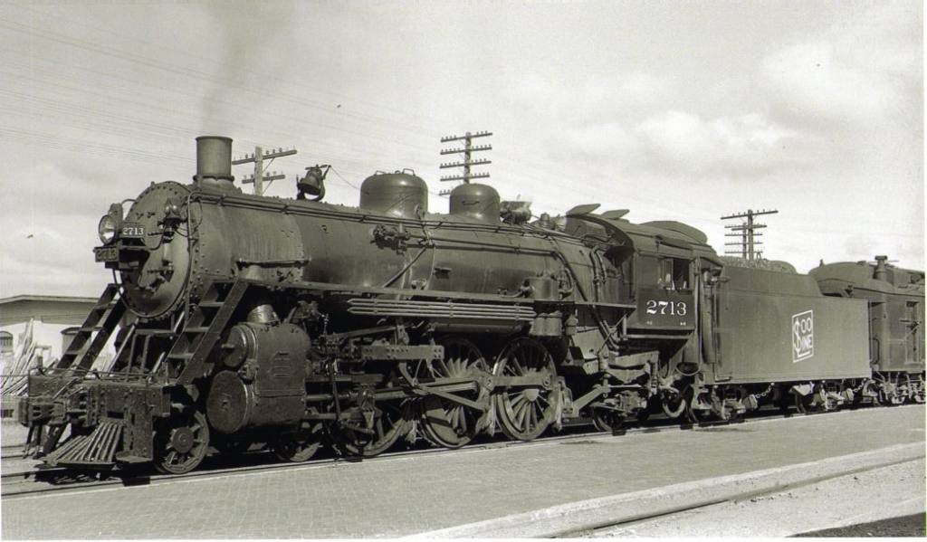
Notes:
But of course not all the bandwidth was needed by the railways. There very quickly came a market for commercial and private messages, and whole businesses sprung up (Western Union dominating in the US) for commercial telegraphy, borrowing on the railway networks and building their own. In the US, Western Union became an effective monopoly (but blew it on the Telephone – they too didn’t see how telephony would kill their telegraph business!)
Western Union delivered a bunch of services based on their telegraph network, including Stock Tickers (‘ticker tape parade’) , Money (wire) transfers, etc.
( Locomotive image from http://www.soo2713.org/pb/wp_89e2d046/wp_89e2d046.html)

Slide 18
Culture
coded messages --
AB BFT CK IF CHN ATE
social networking
technology subculture
Monopoly (Western Union)
Notes:
Many ‘shorthand’ codes were developed, as with optical telegraphy (this is an example of the Phillips code, documented at http://www.morsetelegraphclub.org/files/phillips.pdf).[ About breakfast check if children ate ] So texting shorthand is not so new, after all.
Social concern for telegraphy’s impact on people parallels today’s concerns. “Ella Cheever Thayer's novel "Wired Love" (1879) was based on online romances. An article entitled "The Dangers of Wired Love" (1886) told the story of George McCutcheon, who installed a telegraph in his newsstand and set Maggie, his 20-year old daughter, to operate it. Soon, she was flirting online with several young men including Frank Frisbie, a married man. Father yanked out the telegraph, but Maggie found a job at a nearby telegraph office and resumed the online affair. “ (from http://www.andreas.com/faq-steamnet.html (see also Digital Ego: Social and Legal Aspects of Virtual Identity, By Jacob Van Kokswijk, Eburon , 2007, p58 ).
“Marriages were performed online, with the minister telegraphing the ceremony, and the bride and groom, apart in different cities, taping "I do." All of the telegraph operators along that line were present online at the wedding. “ (from http://www.andreas.com/faq-steamnet.html )
In the novel New Grub Street (1891), the author George Gissing waxed lyrically about the new technology as being the harbinger of the end of literature. (http://www.theglobeandmail.com/books/read-all-about-it-while-you-still-can/article1170699/).

Slide 19
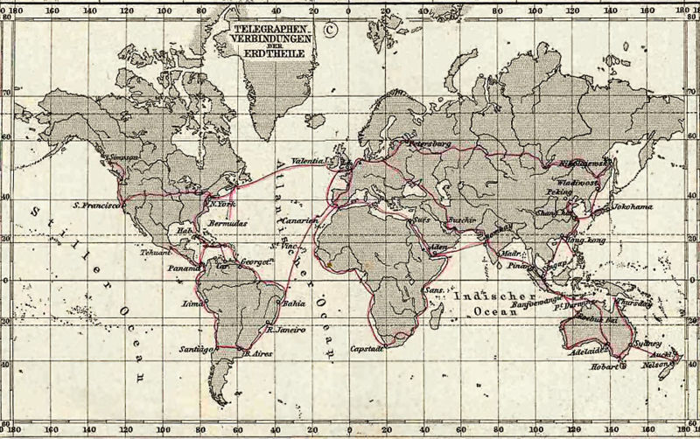
The “1891” World Network
Notes:
When technology made submarine cables possible, telegraphy went international. In the late 19th and early 20th century there was a huge push to wire up the world with intercontinental submarine cables – much like the gold rush in fiber-optic cable laying in the late 1990s early 21st century.
There were strong economic reasons for wireless cables also – communications times were reduced from months, to hours or minutes, enormously improving business’s ability to coordinate seaborne trade.
And, at the same time, there was also an ‘arms race’ (so to speak) in telegraphy – the government that could be most quickly informed of overseas affairs could better manage their concerns. So telegraphy became the currency of international diplomacy.
(underlying graphic from http://en.wikipedia.org/wiki/Image:1891_Telegraph_Lines.jpg. Overlay graphic from http://www.terrastories.com/bearings/radios-rise-during-world-war-I , and a higher-resolution version at www.atlantic-cable.com/Maps/ViaEasternMap.jpg

Slide 20
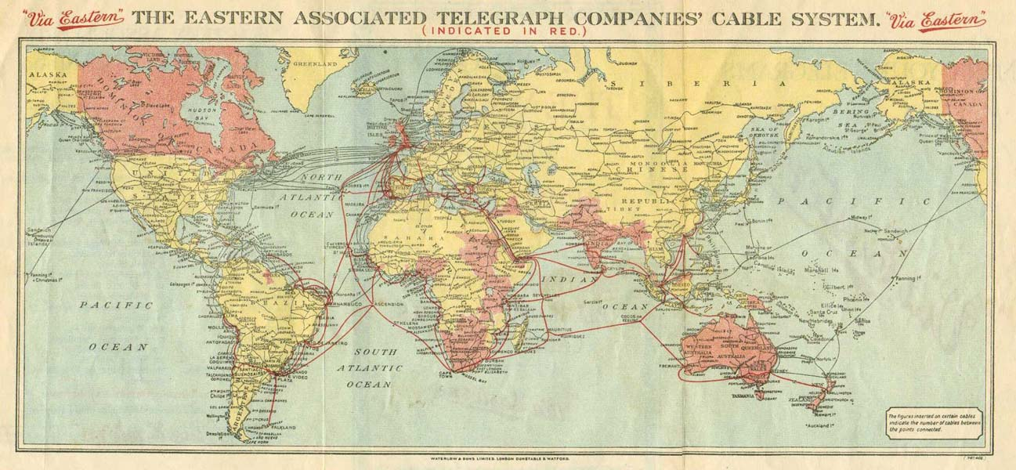
…and circa 1914

Slide 21
“Mr Watson, come here: I want to see you”

Slide 22
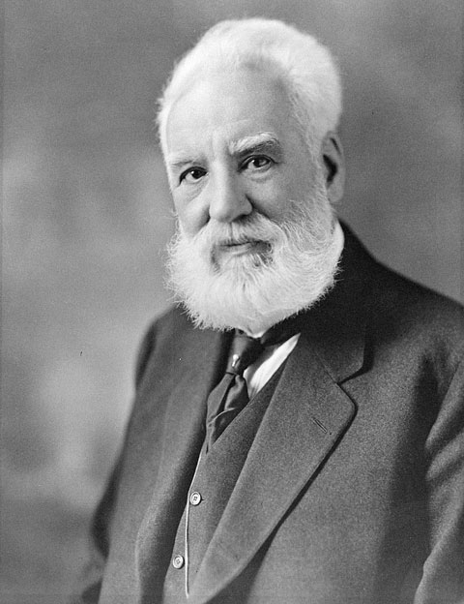
Notes:
Bell’s invention of the telephone was an outgrowth of his interest in developing aids for the hearing impaired – both his parents were deaf, and his passion to help those with hearing impairments drove much of his life’s work.
Indeed, his research on hearing and speech led to investigations of tools to aid hearing, which in turn led indirectly to the telephone – for which he received a patent in 1876. Bell Telephone Company was set up the next year.
Image from: http://en.wikipedia.org/wiki/File:Alexander_Graham_Bell.jpg

Slide 23
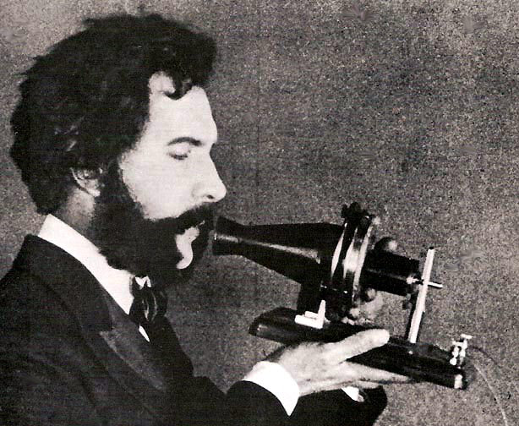
Notes:
The telephone was invented in the late 1870, and was quickly commercialized.
Indeed, telephony also evolved as a side-effect of trying to improve telegraphy: that is, trying to find ways of multiplexing multiple telegraph signals onto the same physical wire. Alexander Graham Bell (A Canadian) was working on this problem (ian outgrowth of his interest in auditory aids) when he happened upon the idea behind the telephone. (
http://www.referenceforbusiness.com/encyclopedia/Str-The/Telephony-Voice-Telecommunications.html)
(Telephone photo from http://en.wikipedia.org/wiki/File:1876_Bell_Speaking_into_Telephone.jpg – a prototype phone built by Bell in 1876).

Slide 24
“What use,” he asked pleasantly, “could this company make of an electrical toy?”
President Orton, of Western Union, refusing a $100,000 plea to purchase the Bell telephone company assets.
Notes:
See: http://www.telephonetribute.com/the_history_of_the_telephone.html for a ‘1910’ history of the telephone,
Western union had no interest in the telephone, and couldn’t see why it would be of interest, as telegraphy was much faster to communicate messages, of various types. Missing the point that telegraphy required trained operators, but anyone could use a telephone, thus exploding the user base.
In a sense, the telephone removed the intermediary of the telegraph office – but telegraph companies didn’t see that, to their detriment.
Funny how things repeat themselves.

Slide 25
Explosive Growth
Notes:
Telephone growth was phenomenal: from 0 to almost 4 million subscribers (in the US) in 30 years. The curve is essentially exponential – just like the initial growth in Internet subscriptions.
This growth drove substantial innovation : both to satisfy customer demands, but also to support enormously increasing scale in user demands. For example, telephone dialing / switching networks replaced operators with patch boards. Multiplexing technologies let multiple ‘virtual’ lines share the same physical line. And developments in signal compression, error correcting coding, and digital compression / multiplexing technologies let the telcos improve the underlying infrastructure while preserving the simple ‘point to point’ connections that make the telephone so easy
But this underlying digital and packet-switched network could also server other purposes. Like the internet.
The overlaid chart of access rates is from: http://www.ipbusinessmag.com/departments.php?department_id=17&article_id=335

Slide 26

Notes:
The “Internet” really began in 1969 – the same year that Neil Armstrong became the first man to land on the moon.
That’s when the first ARPAnet network was created, consisting of a few (<10) computers connected together using the first version of IP.
For long-distance networking, this bootstrapped on top of the telephone network.
Just like the telephone bootstrapped on the telegraph network, 100 years earlier!
Photo: from NASA images library.

Slide 27

Notes:
The “Internet” really began in 1969 – that’s when the first ARPAnet network

